Slide 1
AHS Micro-Air Vehicle Challenge
Group 32:
Kaiyuan Fan, Yingshi Huang, Justin Sherburne

Slide 2
Introduction
Project Sponsor:
Dr. Nancy Squires
CS Team Members:
Yingshi Huang, Kaiyuan Fan, Justin Sherburne
ME Team Members:
Alec Denhert, Tyler Barrett, Christopher McBee
ECE Team Members:
Ian Anderson, Erik Madison, Petar Vukic

Slide 3
Presentation Overview
Competition Rules
Competition Arena
Significant Dates
Image Processing
Hardware Selection
Communication Methods
Autonomous Implementation
Retrospective

Slide 4
Competition Rules
Task A: Design Presentation & Poster : 5-10 minutes
Task B: Indoor Package Delivery Mission: 10 minutes
Vehicle Restrictions:
Vertical takeoff and landing (VTOL) as well as hover capability
Onboard flight-stabilization
Standard communication
Electric-powered vehicle only
Weight < 500g
Size < 45cm in any dimension
Safety control:
Kill Switch and remotely-piloted mode override all autonomous

Slide 5
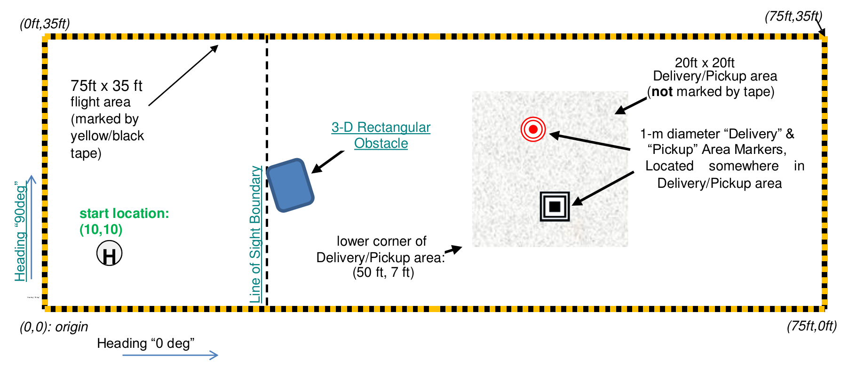
Competition Arena
75ft x 35ft mission boundary (marked by yellow black tape)
1m diameter circle (Home base)
1m length square (Pickup position)
1m diameter circle (Delivery area)

Slide 6
Significant Dates
Gate 1: Paper Submission (Due by January 31, 2018)
Gate 2: Video Evidence of Competition Readiness (Due by 16 March 2018)
Finalists Teams Selection (Announced by 8 April 2018)

Slide 7
Image Processing
Open CV
Open Source
Well documented
Integrates with Pi Camera streaming program
Data Analysis
Object detection
Distance calculation
Active avoidance

Slide 8
Hardware selection
Raspberry Pi zero w
Two camera sensors
Ultrasonic sensors
Wifi Pineapple router
Notes:
Pi zero
-size weight powerful cheap
-not configured for use out of the box
Sensors
-Reliable Lightweight Multifunctional
Camera
-streaming video and find target
Ultrasonic
-detect height and boundary
Router
-no need an external power source
-Available on hand

Slide 9
Communication Methods
2.4GHz wireless channel between base station and vehicle
GPIO pins between ESC motor controllers and Raspberry Pi
GPIO pins between Ultrasonic sensor and Raspberry Pi
Camera module connect with cable at camera port on the Raspberry Pi board
Notes:
Low-latency High-bandwidth

Slide 10
Problems and Solutions
Design changes from Mechanical Team
Competition rules announced late.
Delay on part orders
Sensor placement

Slide 11
Autonomous Implementation
Packages:
Found by cameras, flight based on camera data
Landing Areas:
Found by cameras, flight based on camera and sensor data
Obstacles:
Found by Ultrasonic sensors, flight based on sensor data
Elevation Control:
Based on ultrasonic measurement, controlled by Raspberry Pi

Slide 12
Retrospective
A lot of documentation
Coordinating between groups
Waiting for parts to arrive
Design changes and challenges
Research
… And a bit of coding mixed in

